Slide 1

Milestone 6 - Data Design
January 24th, 2020

Slide 2
Team & Client Introduction
ITI Solutions
Edenbridge Family Services
Notes:
Aidan

Slide 3
Our Team
ITI Solutions
Aidan C. | Team Leader & Database Designer
Harley L. | Liaison Officer & Programmer
Justin A. | Database Developer
Beryon C. | Server Engineer & User Experience
Evan G. | Programmer & User Experience
Notes:
Everyone

Slide 4

Our client
Organization that provides services for people that require special assistance
Government funded/ privately funded organization
Notes:
Aidan

Slide 5
Current system
Edenbridge's current system is paper based with Excel spreadsheets and accounting software
This system has them entering & manipulating 200+ employees' timesheets manually
Notes:
Aidan

Slide 6
Current system problems
It is easy for the coordinators to book workers for overtime because shifts are spread across multiple binders/departments
When shifts are rescheduled it can cause errors in time tracking
The process of entering timecards into Excel is time consuming
Notes:
Aidan

Slide 7
Project description
We are making a scheduling and time-tracking web application for Edenbridge.
Employees will be able to log in through an online portal for different options
Coordinators will be able to schedule workers, workers will be able to view their schedules
Notes:
Aidan

Slide 8
Project description
2 interconnected parts:
Scheduling
Time tracking
System will also be able to generate files that can be exported in to Sage50 accounting or a list of workers with the hours they worked in each department
Notes:
Aidan

Slide 9
Tables and relationships
Entity Relationship Diagrams
Business Rules
Data Dictionary
Notes:
Justin

Slide 10
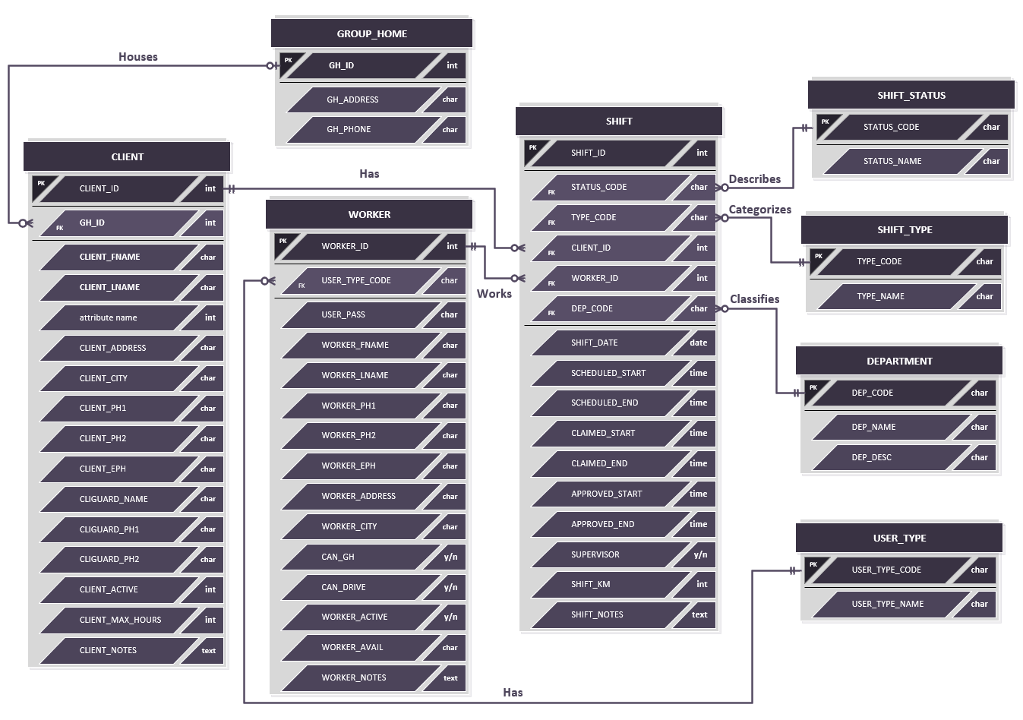
Entity Relationships
Notes:
Justin

Slide 11
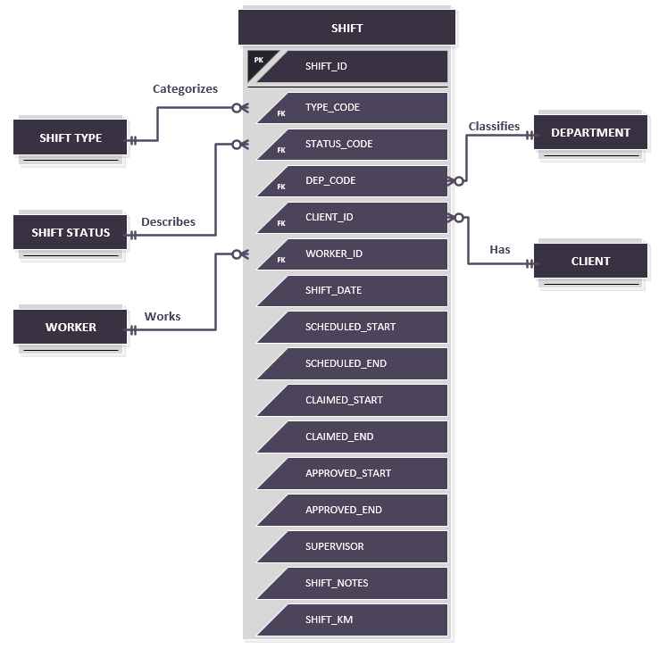
Shift Table
Notes:
Justin

Slide 12
Shift Table – Rules and Data
SHIFT_ID | TYPE_CODE | CLIENT_ID | WORKER_ID | DEP_CODE | STATUS_CODE | SHIFT_DATE
1 | GHD | 25 | 3 | GH | C | 12/11/2019
2 | INT | 52 | 87 | PDO | S | 1/3/2020
SCHEDULED_START | SCHEDULED_END | CLAIMED_START | CLAIMED_END | APPROVED_ START | APPROVED_ END | SUPERVISOR | SHIFT_NOTES | SHIFT_KM
13:00 | 18:00 | 10:30 | 16:00 | 11:00 | 16:00 | 1 | Notes go here | 23
8:00 | 12:00 | 8:30 | 12:00 | 8:30 | 12:00 | 0 | Notes go here | 40
Many shifts can be for one client
Many shifts can be worked by one worker
Many shifts can be categorized by one shift type
Many shifts can by classified into one department
Many shifts can be described by one shift status
Notes:
Justin

Slide 13
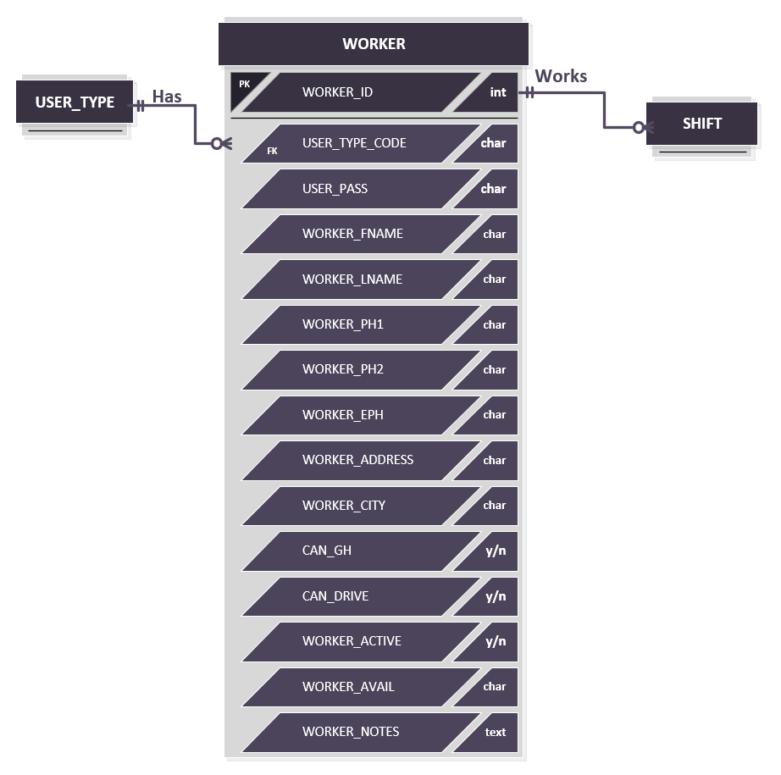
Worker table
Notes:
Justin

Slide 14
Worker table – Rules and Data
WORKER_ ID | USER_TYPE_ CODE | USER_PASS | WORKER_ FNAME | WORKER_ LNAME | WORKER_ADDRESS | WORKER_ CITY | WORKER_PH1
1 | W | Password1 | Bob | Smith | 123 Some St. | Lethbridge | Xxx-xxx-xxxx
2 | W | qwerty | Jim | Halpert | 456 Another St. | Lethbridge | Xxx-xxx-xxxx
WORKER_PH2 | WORKER_EPH | CAN_GH | CAN_DRIVE | WORKER_ACTIVE | WORKER_AVAIL | WORKER_NOTES
Xxx-xxx-xxxx | Xxx-xxx-xxxx | 1 | 1 | 1 | Wed,8:00-23:00; | Notes go here
Xxx-xxx-xxxx | Xxx-xxx-xxxx | 0 | 1 | 1 | Tue,4:00-20:00; | Notes go here
One worker can work many shifts
One shift is worked by one worker
Notes:
Justin

Slide 15
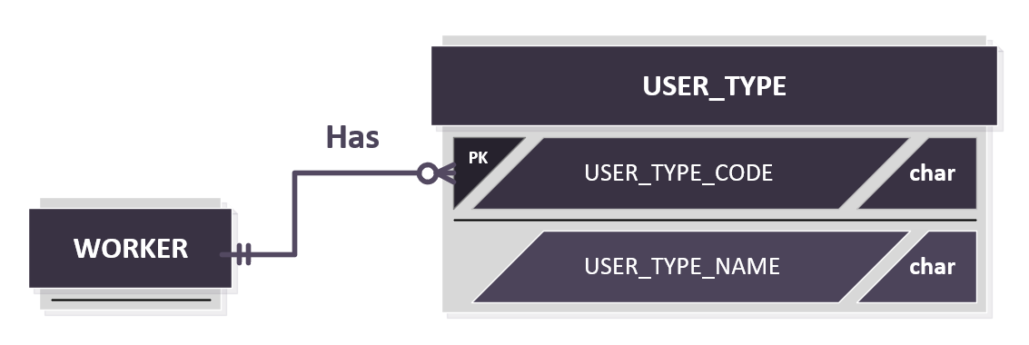
USER type table
Notes:
Justin

Slide 16
User type table – Rules and Data
USER_TYPE_CODE | USER_TYPE_NAME
W | Worker
C | Coordinator
A | Administrator
One User Type applies to many employees
One employee has one user type
Notes:
Justin

Slide 17
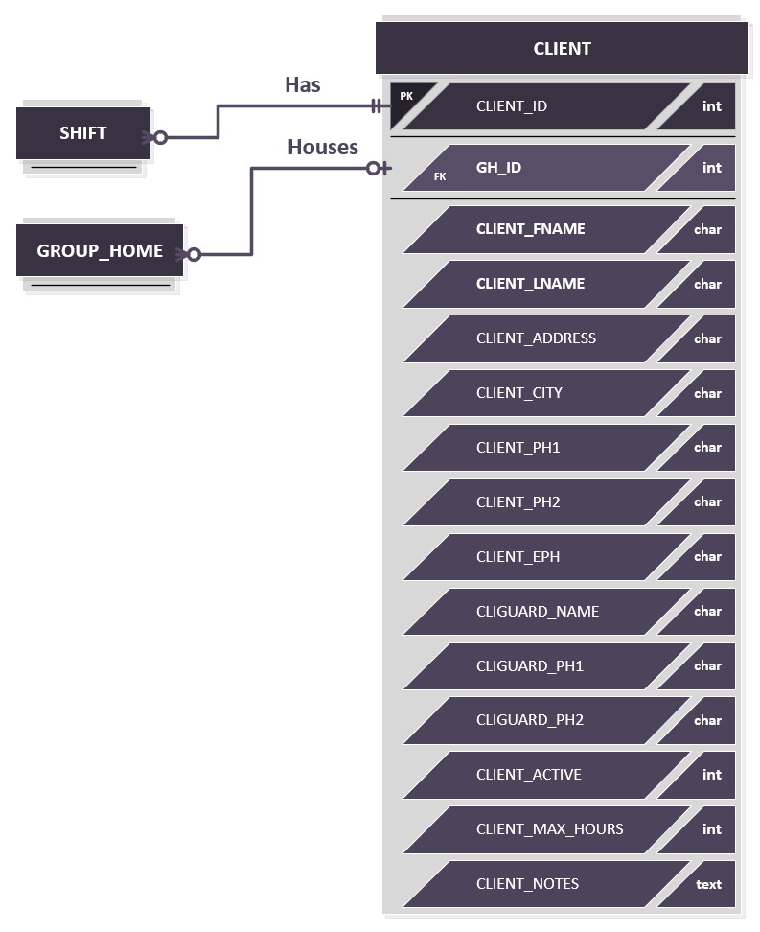
Client table
Notes:
Evan

Slide 18
Client table – Rules and Data
CLIENT_ID | GH_ID | CLIENT_ FNAME | CLIENT_ LNAME | CLIENT_ADDRESS | CLIENT_CITY | CLIENT_PH1 | CLIENT_PH2
1 | 1 | Jeremy | Clarkson | 123 Sample St. | Lethbridge | Xxx-xxx-xxxx | Xxx-xxx-xxxx
2 | 0 | Jessie | McDonald | 456 another St. | Lethbridge | Xxx-xxx-xxxx | Xxx-xxx-xxxx
CLIENT_ EPH | CLIGUARD_ NAME | CLIGUARD_ PH1 | CLIGUARD_ PH2 | CLIENT_ KM | CLIENT_MAX_ HOURS | CLIENT_ ACTIVE | CLIENT_ NOTES
Xxx-xxx-xxxx | Tom | Xxx-xxx-xxxx | Xxx-xxx-xxxx | 5 | 20 | 1
Xxx-xxx-xxxx | Jorge | Xxx-xxx-xxxx | Xxx-xxx-xxxx | 10 | 15 | 1
One client can have many shifts
One shift is for one client
Many clients can live in one group home
One client lives in up to one group home
Notes:
Evan

Slide 19
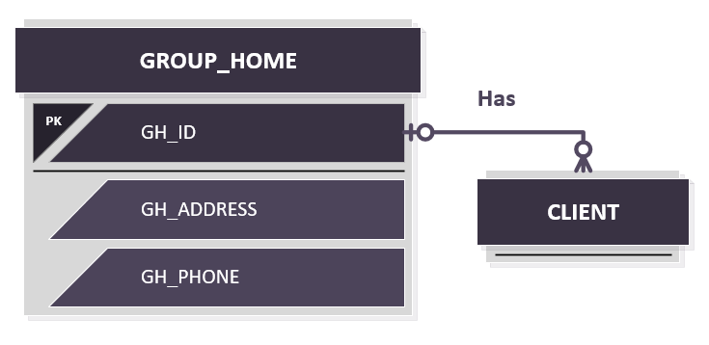
Group home table
Notes:
Evan

Slide 20
Group home table – Rules and Data
GH_ID | GH_ADDRESS | GH_PHONE
1 | 123 Some St. | Xxx-xxx-xxxx
2 | 456 Another St. | Xxx-xxx-xxxx
One group home can have many clients
One client can live in one group home
Notes:
Evan

Slide 21
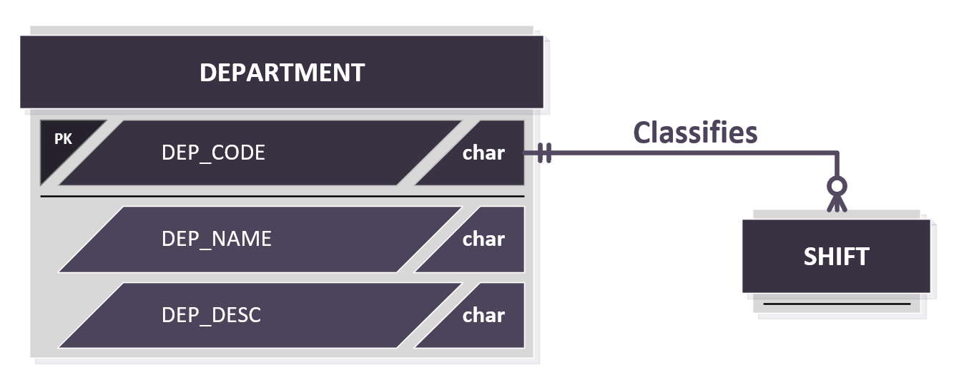
Department table
Notes:
Evan

Slide 22
Department table – Rules and Data
DEPT_CODE | DEPT_NAME | DEPT_DESC
CTO | CTO | Supportive Community Treatment Order
CLD | Children | Working with children
PRI | Private | Private client
One department can classify many shifts
One shift can be classified into one department
Notes:
Evan

Slide 23
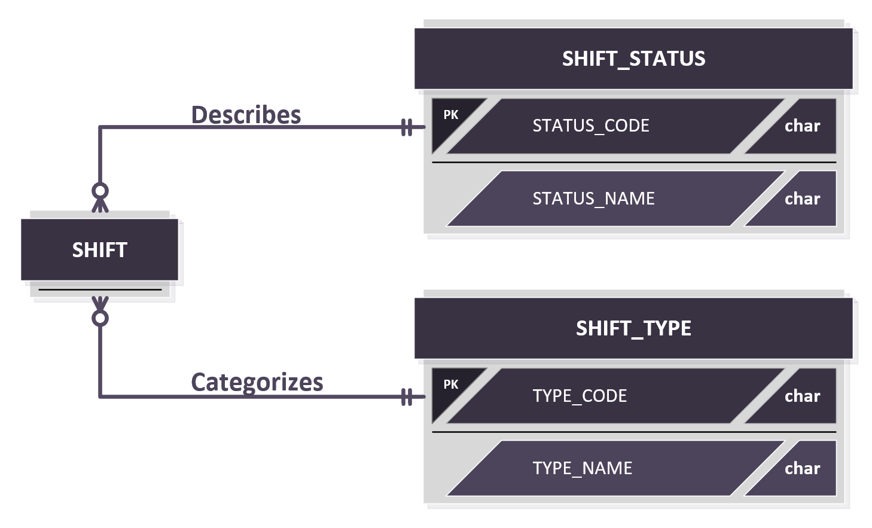
shift status & type tables
Notes:
Evan

Slide 24
shift status & type tables – Rules and Data
TYPE_CODE | TYPE_NAME
GHD | Group Home - day
GHN | Group Home - night
INT | In town
STATUS_CODE | STATUS_NAME
C | Completed
S | Scheduled
A | Approved
One shift type categorizes many shifts
One shift status can describe many shifts
One shift is described by one shift status
One shift is categorized by one shift type
Notes:
Evan

Slide 25
Table | Field name | Description | Data Type | Data Format | Field Size | Required | PK or FK | FK Reference Table | Example
SHIFT | SHIFT_ID | ID number used to uniquely identify a shift. | INT | --------------------------- | 20 | Y | PK |  | 1234
 | TYPE_CODE | Code used to uniquely identify the type of shift. | VARCHAR | --- | 3 | Y | FK | SHIFT_TYPE | GHD
 | STATUS_CODE | Code used to uniquely identify the status of a shift. | VARCHAR | --- | 3 | Y | FK | SHIFT_STATUS | C
 | DEPT_CODE | Code used to uniquely identify a department. | VARCHAR | --- | 3 | Y | FK | DEPARTMENT | PRI
 | CLIENT_ID | ID number used to uniquely identify a client. | INT | --------------------------- | 20 | Y | FK | CLIENT | 1234
 | WORKER_ID | ID number used to uniquely identify a worker. | INT | --------------------------- | 20 | Y | FK | WORKER | 1234
 | SHIFT_DATE | The date of a shift. | DATE | YYYY-MM-DD | 9 | Y |  |  | 1975-10-10
Notes:
Beryon

Slide 26
Table | Field name | Description | Data Type | Data Format | Field Size | Required | PK or FK | FK Reference Table | Example
SHIFT | SCHEDULED_START | The time of day a shift has been scheduled to start | TIME | HH:MM | 8 | Y |  |  | 00:24:24
 | SCHEDULED_END | The time of day a shift has been scheduled to end. | TIME | HH:MM | 8 | Y |  |  | 00:24:24
 | CLAIMED_START | The time of day a worker claimed to start a shift. | TIME | HH:MM | 8 | Y |  |  | 00:24:24
 | CLAIMED_END | The time of day a worker claimed to end a shift. | TIME | HH:MM | 8 | Y |  |  | 00:24:24
 | APPROVED_START | The time of day the shift started after being confirmed. | TIME | HH:MM | 8 | Y |  |  | 00:24:24
 | APPROVED_END | The time of day the shift ended after being confirmed. | TIME | HH:MM | 8 | Y |  |  | 00:24:24
 | SUPERVISOR | Boolean variable showing if the worker is the supervisor for that shift | TINYINT | 0/1 | 1 | Y |  |  | 0
 | SHIFT_KM | Distance travelled by worker for that shift | INT | ---km | 3 | N |  |  | 50km
 | SHIFT_NOTES | Any extra information necessary for the person working the shift. | LONGTEXT | --------------------------- | 150 | N |  |  | Some specific thing to take into consideration.
Notes:
Beryon

Slide 27
Table | Field name | Description | Data Type | Data Format | Field Size | Required | PK or FK | FK Reference Table | Example
SHIFT_TYPE | TYPE_CODE | Code used to uniquely identify the type of shift. | VARCHAR | --- | 3 | Y | PK |  | GHD
 | TYPE_NAME | Name of the type of shift | VARCHAR | --------------------------- | 20 | Y |  |  | Group home day
CLIENT | CLIENT_ID | ID number used to uniquely identify a client. | INT | --------------------------- | 20 | Y | PK |  | 1234
 | GH_ID | ID number used to uniquely identify a group home. | INT | --------------------------- | 20 | Y | FK | GROUP_HOME | 1234
 | CLIENT_LNAME | The first name of a client. | VARCHAR | --------------------------- | 20 | Y |  |  | Picard
 | CLIENT_FNAME | The last name of a client. | VARCHAR | --------------------------- | 20 | Y |  |  | William
 | CLIENT_ADDRESS | The address of a client. | VARCHAR | --------------------------- | 40 | Y |  |  | 1234 Street St.
 | CLIENT_CITY | The settlement a client lives in. | VARCHAR | #-###-###-#### | 20 | Y |  |  | 1-123-123-1234
 | CLIENT_PH1 | Primary phone number of a client. | VARCHAR | #-###-###-#### | 14 | Y |  |  | 1-123-123-1234
 | CLIENT_PH2 | Secondary phone number of a client. | VARCHAR | #-###-###-#### | 14 | N |  |  | 1-123-123-1234
Notes:
Beryon

Slide 28
Table | Field name | Description | Data Type | Data Format | Field Size | Required | PK or FK | FK Reference Table | Example
CLIENT | CLIENT_EPH | Emergency phone number of a client. | VARCHAR | #-###-###-#### | 14 | N |  |  | 1-123-123-1234
 | CLIGUARD_NAME | Name of a client’s guardian. | VARCHAR | --------------------------- | 20 | N |  |  | Jean
 | CLIGUARD_PH1 | Primary phone number of a client’s guardian. | VARCHAR | #-###-###-#### | 14 | N |  |  | 1-123-123-1234
 | CLIGUARD_PH2 | Secondary phone number of a client’s guardian. | VARCHAR | #-###-###-#### | 14 | N |  |  | 1-123-123-1234
 | CLIENT_ACTIVE | Whether the client is being actively served. | TINYINT | 0/1 | 1 | Y |  |  | 0
 | CLIENT_MAX_HOURS | Maximum number of hours that can be allocated to client. | FLOAT | ##.## | 4 | N |  |  | 56.75
 | CLIENT_NOTES | Any extra information about the client. | LONGTEXT | --------------------------- | 150 | N |  |  | Some specific thing to take into consideration.
Notes:
Beryon

Slide 29
Table | Field name | Description | Data Type | Data Format | Field Size | Required | PK or FK | FK Reference Table | Example
WORKER | WORKER_ID | ID number used to uniquely identify a worker. | INT | --------------------------- | 20 | Y | PK |  | 1234
 | WORKER_LNAME | The last name of a worker. | VARCHAR | --------------------------- | 20 | Y |  |  | Smith
 | WORKER_FNAME | The first name of a worker. | VARCHAR | --------------------------- | 20 | Y |  |  | Jane
 | WORKER_ADDRESS | A worker’s address. | VARCHAR | --------------------------- | 40 | Y |  |  | 1234 Street St.
 | WORKER_CITY | The settlement a worker lives in. | VARCHAR | --------------------------- | 20 | Y |  |  | Settleville
 | WORKER_PH1 | Primary phone number of a worker. | VARCHAR | #-###-###-#### | 20 | Y |  |  | 1-123-123-1234
 | WORKER_PH2 | Secondary phone number of a worker. | VARCHAR | #-###-###-#### | 20 | N |  |  | 1-123-123-1234
 | WORKER_EPH | Emergency phone number of a worker. | VARCHAR | #-###-###-#### | 20 | N |  |  | 1-123-123-1234
 | ACTIVE | Whether the worker is actively working for the company. | TINYINT | 0/1 | 1 | Y |  |  | 1
 | CAN_GH | Whether a worker can work in a group home or not. | TINYINT | 0/1 | 1 | Y |  |  | 1
 | CAN_DRIVE | Shows if a worker can drive for work. | TINYINT | 0/1 | 1 | Y |  |  | 1
 | WORKER_NOTES | Any extra information about the worker. | LONGTEXT | --------------------------- | 150 | N |  |  | Some specific thing to take into consideration.
Notes:
Beryon

Slide 30
Table | Field name | Description | Data Type | Data Format | Field Size | Required | PK or FK | FK Reference Table | Example
WORKER | USER_PASS | A user's password. | VARCHAR | -------------------------- | 20 | Y |  |  | qwerty
DEPARTMENT | DEPT_CODE | Code used to uniquely identify a department. | VARCHAR | --- | 3 | Y | PK |  | PRI
 | DEPT_NAME | Name of a department. | VARCHAR | --------------------------- | 20 | Y |  |  | Private
 | DEPT_DESC | Description of a department. | VARCHAR | ---------------------------- | 50 | Y |  |  | Children department is for working with children
GROUP_HOME | GH_ID | ID number used to uniquely identify a group home. | INT | --------------------------- | 20 | Y | PK |  | 1234
 | GH_ADDRESS | The address of a group home. | VARCHAR | --------------------------- | 40 | Y |  |  | 1234 Street St.
 | GH_PHONE | The phone number of a group home. | VARCHAR | #-###-###-#### | 14 | Y |  |  | 1-123-123-1234
SHIFT_STATUS | STATUS_CODE | Code used to uniquely identify the status of a shift. | VARCHAR | --- | 3 | Y | PK |  | S
 | STATUS_NAME | Name of a shift’s status. | VARCHAR | --------------------------- | 20 | Y |  |  | Scheduled
Notes:
Beryon

Slide 31
Data backup, recovery, and archival
Backup/Restoration Plan
Data Archival Plan
Notes:
Harley

Slide 32
Data backup
Backups will be done periodically, with a backup process being executed once per day at night.
We can use the "Cron" utility to schedule a “mysqldump” to be executed on a chronological basis.
We can send database backups to the server located in their office with SFTP.
Altis currently has a backup plan with Edenbridge, they back up the data on the server in their office twice per day.
Notes:
Harley

Slide 33
Data restoration
In the event of data loss the database will need to be restored.
We can easily achieve this by using the dump file we will have saved elsewhere.
The dump file will be comprised of SQL statements that will allow the database to be rebuilt in its previous state.
Notes:
Harley

Slide 34
Data archival
Shift information will be kept for two years before being archived.
New data will be added to the archive periodically.
We will devise algorithms for using PHP to check that all referential integrity is maintained so we may remove old data from the active database when it has reached its expiry date, without causing problems with the data structure.
Notes:
Harley

Slide 35
Conclusion
Table structure designed for versatility and reliability
Nature of the data involved necessitates backup/archival, for which recommendations are given
Notes:
Beryon

Slide 36
Looking Forwards
Next Month
Next Three Months
Designing UI
Process flow design
Input/output finalization
Physical & technical architecture design
Finishing implementation
testing of components
Establishing training regimen
Delivery to client
Notes:
Beryon

Slide 37
Questions?

